Slide 1
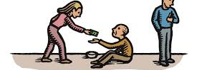
Prisoner’s Dilemma Simulation
Evolution of Alturism

Slide 2
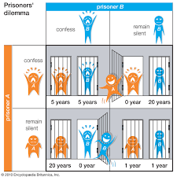
Prisoner’s Dilemma
You can choose to act altruistically or selfishly

Slide 3
My Simulation
More successful programs get to “reproduce” more
Tracks evolution of Moral Strategies
Hypothesis: Altruistic strategies will outcompete selfish strategies

Slide 4
Implementation
Linked list
Each “node” like an organism with a memory
More added based on competitions
Every other node deleted when list becomes too large

